Slide 1



Lecture 1
NanoTechnology:
What is It?
Jon A Preece, FRSC
Professor of Nanoscale Chemistry
School of Chemistry
University of Birmingham

Slide 2



NanoTechnology or NanoFiction

Slide 3

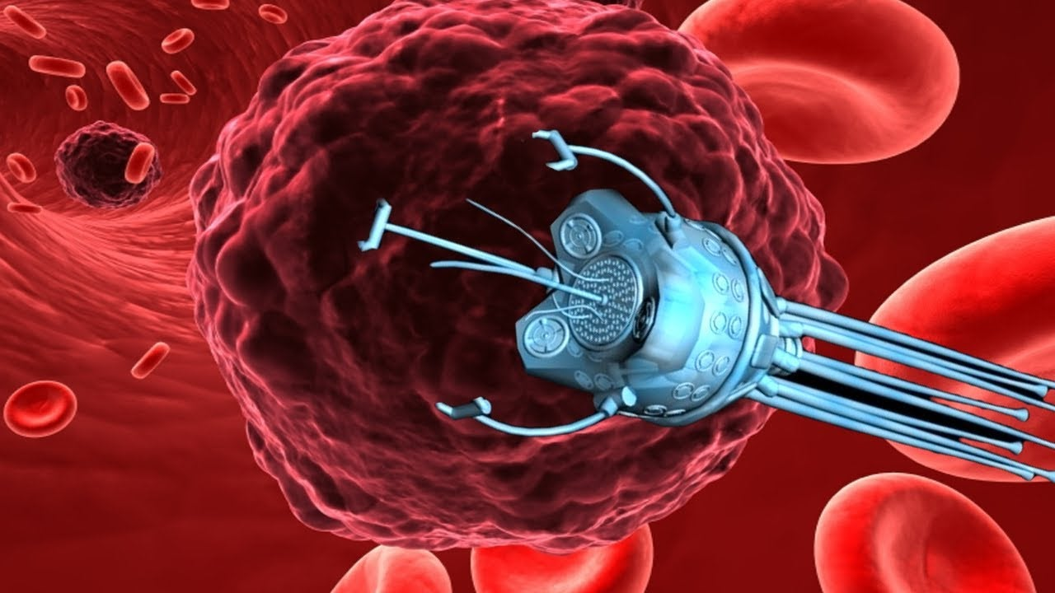
NanoTechnology or NanoFiction
In the Nevada desert, an experiment has gone horribly wrong. A cloud of nanoparticles has escaped from the laboratory.
This cloud is self-sustaining and self-reproducing. It is intelligent and learns from experience.
For all practical purposes, it is alive. It has been programmed as a predator.
It is evolving swiftly, becoming more deadly with each passing hour. Every attempt to destroy it has failed.
And we are the prey.
As fresh as today's headlines, Michael Crichton's most compelling novel yet tells the story of a mechanical plague and the desperate efforts of a handful of scientists to stop it.
Drawing on up-to-the-minute scientific fact, Prey takes us into the emerging realms of nanotechnology and artificial distributed intelligence - in a story of breathtaking suspense.
Prey is a novel you can't put down. Because time is running out!!
Have you used any Nanotechnology today?
Should You Lose Any Sleep Tonight!?

Slide 4
Learning Objectives
By the end of this lecture you should appreciate and understand:
The relationship between science, innovation and technology
Length scales from macro to micro to nano to molecular to atoms
The definition of nanotechnology
What a nanomedicine is
What nanoelectronics is
What nanofabrication is
What nanomaterials are
The allotropes of carbon beyond diamond and graphite
The structure and bonding in graphene
The structure of carbon nanotubes and their relationship to graphene
Geodesic structures and how they relate to the carbon allotropes of buckminsterfullerene (C₆₀)

Slide 5
The Relationship Between Science & Technology
Application of Science/Engineering to Address a Human Need Leads to New Technologies
Science Builds Technology
Science
Knowledge
Fundamental universal understanding of processes and materials to generate knowledge
Technology
Products
Application of knowledge to address a human need, by the utilisation of a processes and/or materials
Innovation
Technology Builds Tools to Discover New Science

Slide 6
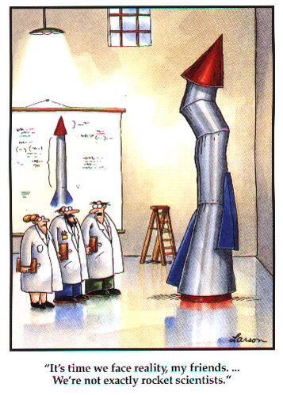


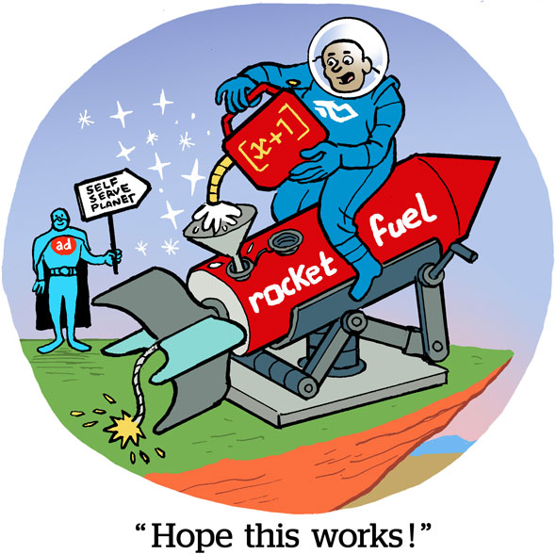
Science – Innovation – Technology
Engineering
Innovation
Physics
Space Flight
Newton’s Laws of Motion
Chemistry

Slide 7
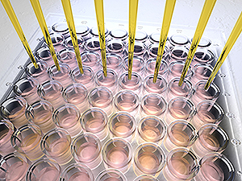

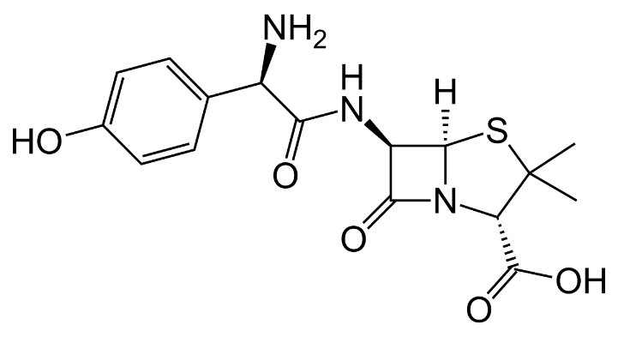

Science – Innovation – Technology
Biology
Innovation
Chemistry
New Drug
Medicine

Slide 8

What Does ‘Nano’ Mean?
You are familiar with using the term decimetre, (dm), centimetre (cm) and millimetre (mm)
1 decimetre 1 dm 0.1 m 10⁻¹ m tenth of metre
1 centimetre 1 cm 0.01 m 10⁻² m hundredth of metre
Of course, you can see all these on a ruler with your eye
1 millimetre 1 mm 0.001 m 10⁻³ m thousandth of a metre
You can just about see 0.1 of a mm, or 100 μm, the width of a hair from your head.
To see below 100 μm to 0.2 μm (200 nm) you need an optical microscope.
Now, imagine taking 1 mm and dividing that up into 1000 equal pieces.
1 micrometer 1μm 0.000001 m 10⁻⁶ m millionth of a metre
To see below 200 nm (0.2 μm) requires advanced microscopic technologies.
1 nanometer 1nm 0.000 000 001 10⁻⁹ m billionth of a metre
Now, imagine taking 1 μm and dividing that up into 1000 equal pieces.

Slide 9


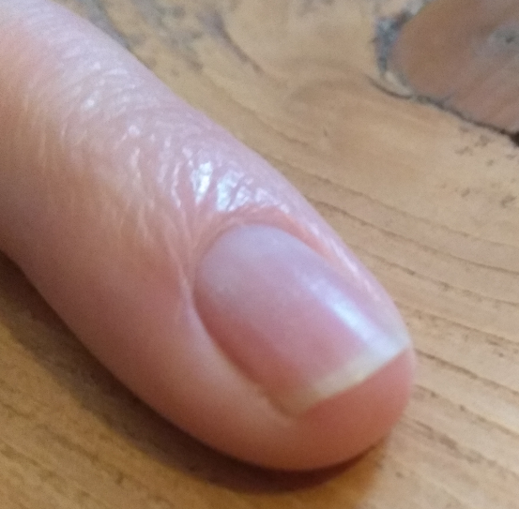

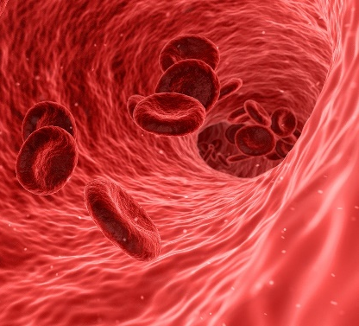
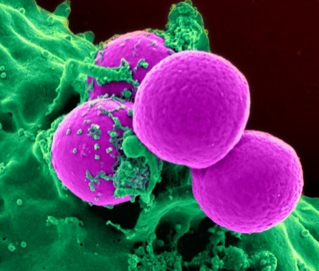
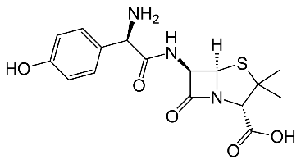
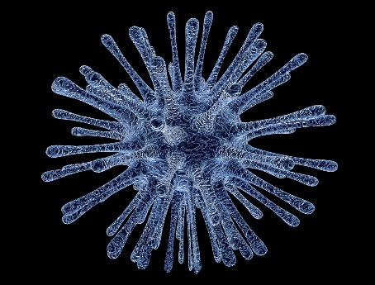
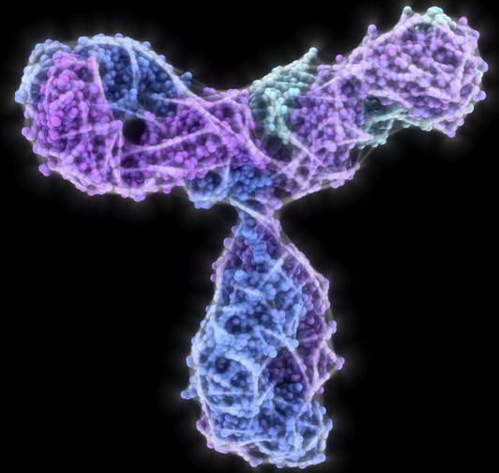
Making Sense of a Nanometre (nm)
Macroscopic
Visible to the naked eye
down to about 50 μm
(0.05 mm, 50 000 nm)
Divide by 10
1 m
10⁰ m
Divide by 10
10 cm
10⁻¹ m
Atom Diameters
He = 0.186 nm
Fr = 0.528
Divide by 10
1 cm
10⁻² m
Microscopic
Visible with an
optical microscope
down to 0.2 μm
(200 nm)
Divide by 10
1 mm
10⁻³ m
Divide by 10
100 μm
10⁻⁴ m
Nanoscopic
Visible with advanced resolution
Microscopies
0.1nm - 200 nm
Divide by 10
10 μm
10⁻⁵ m
Molecular
Divide by 10
1 μm
10⁻⁶ m
Divide by 10
100 nm
10⁻⁷ m
Divide by 10
10 nm
10⁻⁸ m
A
tomi
c
1 nm
10⁻⁹ m

Slide 10
What is Nanotechnology?
A technology involving a material or process with a length scale between 1 to 100 nm
Technologies involving this length scale are now pervasive across most industrial sectors
You will have undoubtedly used NanoTechnology already today if you have used an electronic device (phone, computer, tablet, games console).
NanoMedicine
NanoFabrication
NanoElectronics
NanoMaterials

Slide 11
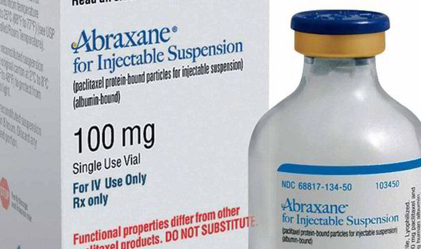
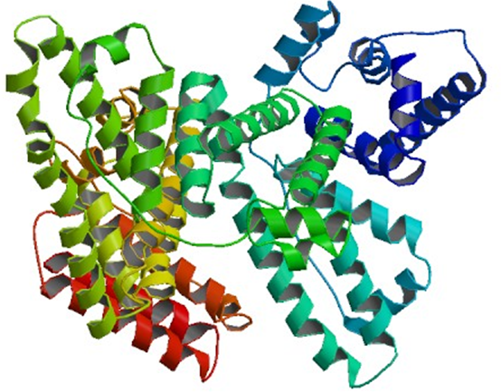
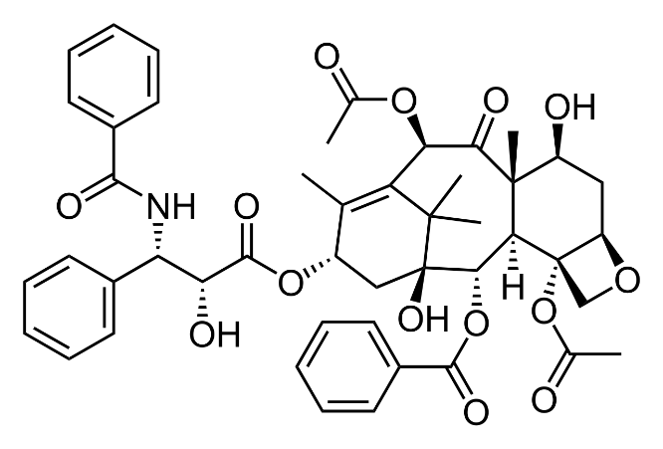
NanoMedicine: Abraxane
Abraxane® is the first approved nanotechnology-based chemotherapeutic (nab-paclitaxel).
Abraxane is used to treat advanced cancer of the breast, lung, or pancreas.
Abraxane is a formulation of Paclitaxel and the natural nanoparticle Albumin.
7 nm
Paclitaxel: Used for the treatment of ovarian cancer, breast cancer, lung cancer, Kaposi sarcoma, cervical cancer, and pancreatic cancer. It is given by injection into a vein.
Albumin: A naturally occurring protein nanoparticle found in blood plasma.
It accumulates in cancer cells.
Albumin
2 nm
Paclitaxel
Albumin can make Paclitaxel soluble in blood plasma and take it into cancer cells.
Challenge: it is hydrophobic, e.g. it has poor solubility in aqueous based media (e.g. blood plasma), and therefore it efficacy is poor.
Solution: Attach it to a hydrophophilic material.

Slide 12
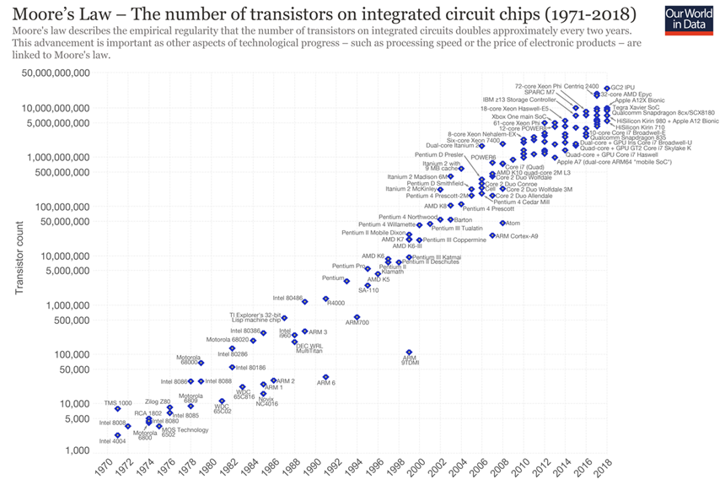
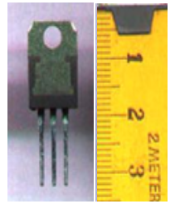
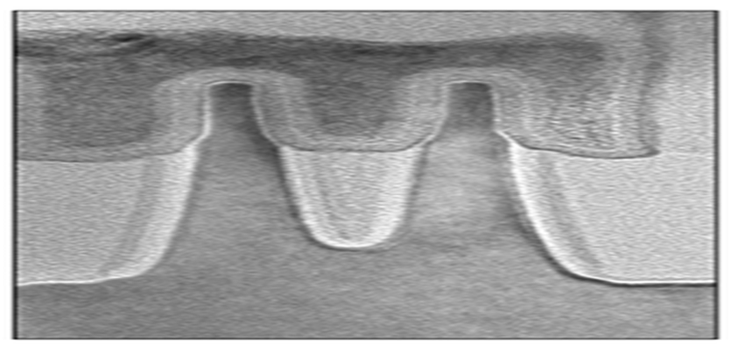
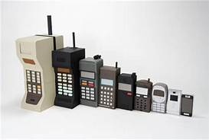
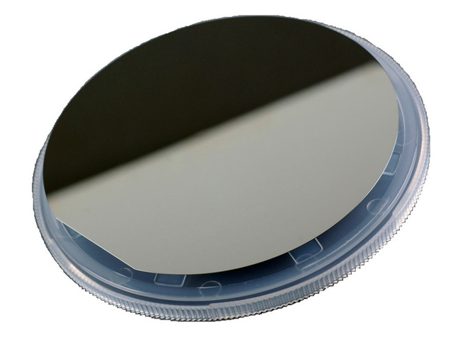
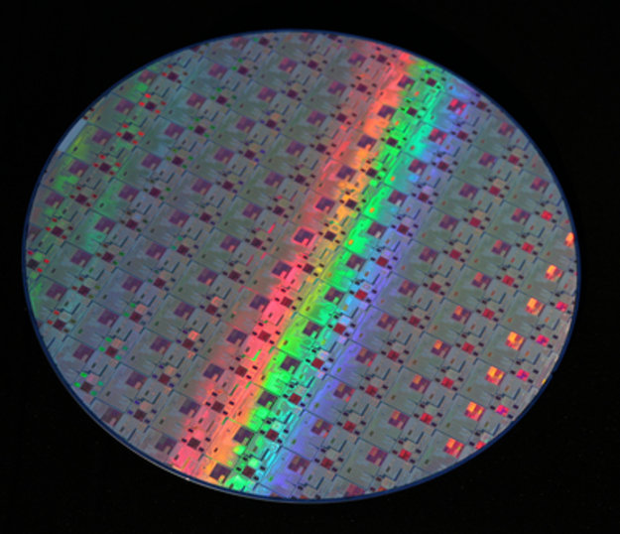
NanoFabrication and NanoElectronics:Transistor Manufacture
Pre 1970s Transistors
NanoTransistor Manufactured
Today
Transistors are ubiquitous.
They control many everyday electronic devices.
Gate
Source
Drain
14 nm
Source
Drain
Gate
A processed silicon wafer
containing many billions of transistors
A virgin 12 inch silicon wafer
Photolithography
History might look back on Photolithography as one of the most important processes humankind has produced.

Slide 13
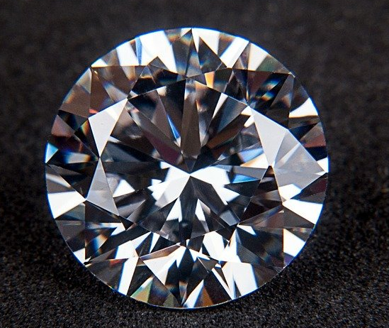

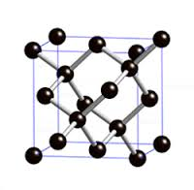
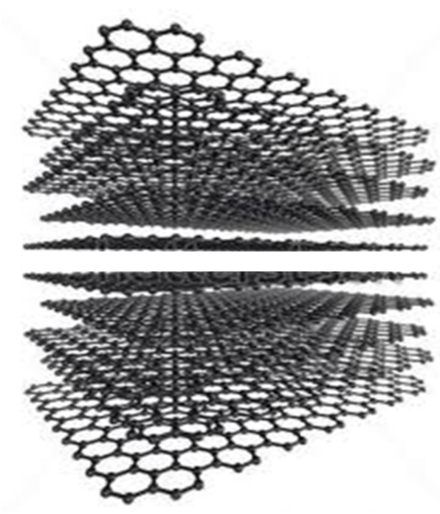
Carbon Materials
Diamond and graphite are both formed from carbon atoms.
Diamond
Graphite
They are referred to as allotropes of carbon.
They are not nanomaterials as they form infinite arrays of atoms in 3D.
‘Infinite’ 2D sheets
of carbon atoms
Layered one on top of each other
‘Infinite’ 3D array
of carbon atoms

Slide 14
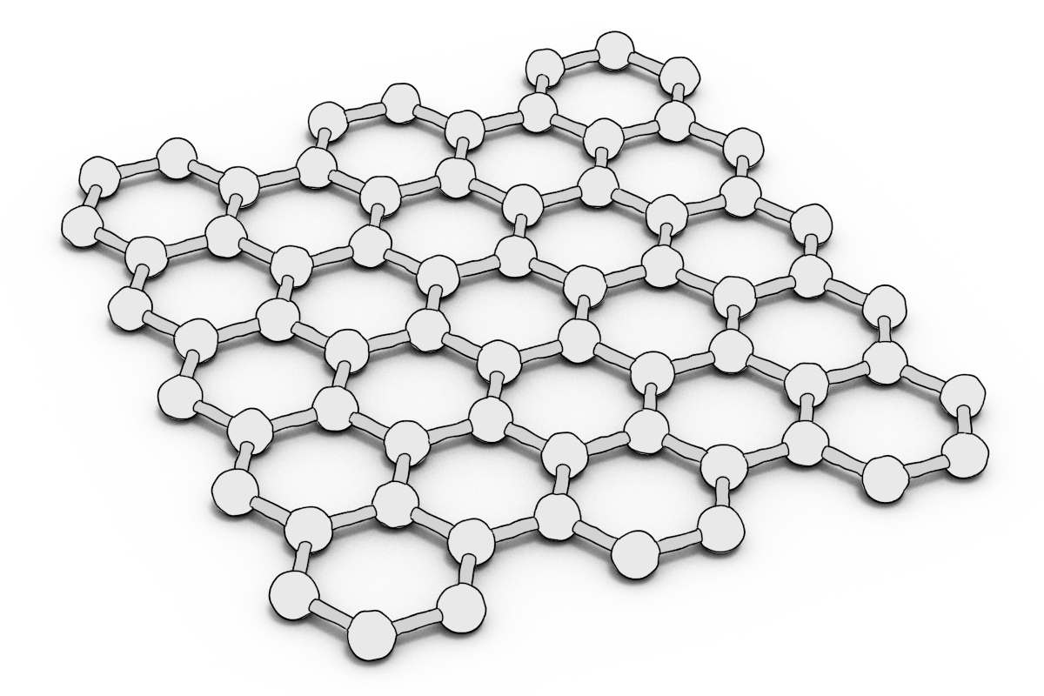
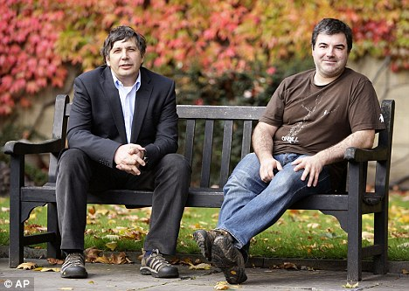
NanoMaterial: Graphene
Graphene
Prof Sir Andre Geim, Dr Konstantin Novoselov
2010 Physics Nobel Prize Winner
for groundbreaking experiments regarding the two-dimensional material graphene
Graphene physical Properties
Very Light and Strong
Excellent Electricity Conductor
Excellent Heat Conductor
Technological Applications:
‘Head’ Tennis Racquets For increased Strength
Smart phone touch screens
Batteries

Slide 15
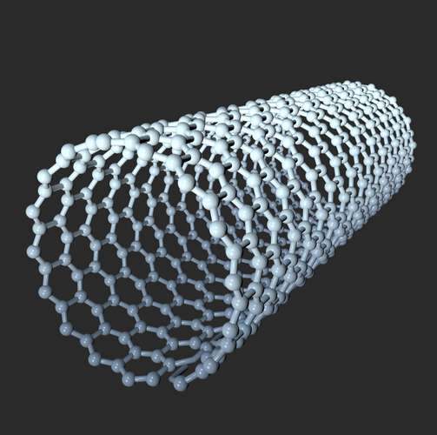
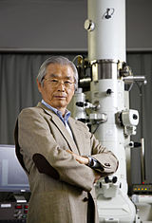
NanoMaterial: Bucky Tubes
Bucky Tube
Prof Sir Harry Kroto
Sumio Iijima
Discovered Bucky Tubes in 1990
Carbon Nanotubes Physical Properties
Very Light and Strong
Excellent Electricity Conductor
Excellent Heat Conductor
Can be very long
Technological Applications:
Used in a Resins to Give Very Strong Composite
Hybtonite
Used in Bike Frame Components
https://www.graphene.manchester.ac.uk/learn/applications/

Slide 16
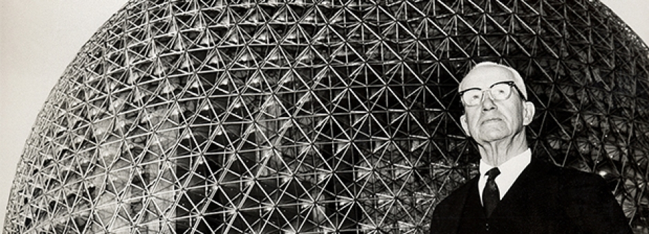

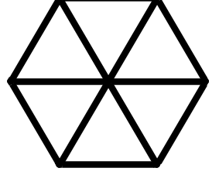
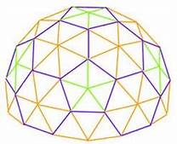
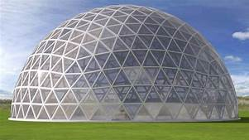
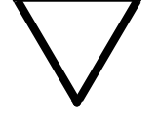
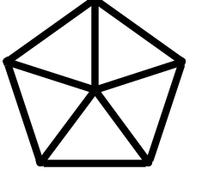
3D Carbon NanoMaterials and an Architect
Triangles are do not deform.
Making Hexagons and Pentagons out of Triangle makes them strong.
Combining Hexagons and Pentagons leads to curvature and 3D Shapes.
Richard Buckminster Fuller 1895-1983
Architect
Used Geosdesic Dome in Architecture
pentagon
hexagon
hexagon
Hexagons
pentagon
Triangles
Pentagons

Slide 17
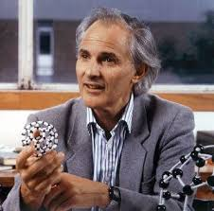
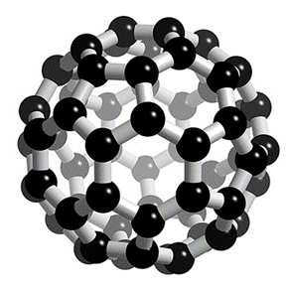

Carbon NanoMaterial: C₆₀
Buckminsterfullerene or C₆₀
C₆₀
Diameter
0.86 nm
Prof Sir Harry Kroto
Interview with Prof Kroto
https://www.youtube.com/watch?v=XCVm9zExrlI
Sir Harry Kroto, Robert Curl, Richard Smalley
1996 Chemistry Nobel Prize Winner
for their discovery of fullerenes
https://www.youtube.com/watch?time_continue=186&v=4z8Q0aUKuUU&feature=emb_logo
Physical Properties:
Good Absorber of Light
Good Acceptor of Electrons
Mechanically strong
Potential Technological Applications:
Organic Solar Cell Devices
Resists for use in Nanofabrication
https://sciencestruck.com/applications-of-fullerenes
These 3 carbon-based nanomaterials are collectively called Engineered Nanoparticles as they are manufactured

Slide 18

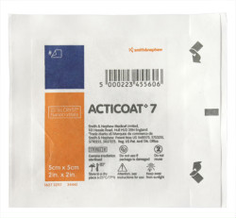
Other NanoMaterials and Their Products
TiO₂ and ZnO₂ Nanoparticles in Sunscreen
Titanium dioxide and zinc oxide nanoparticles absorb UVA and UVB light efficiently.
Therefore, these nanoparticles are used in cosmetics as suncreens.
Silver Nanoparticles in Wound Dressings
Ag nanoparticles are exceptionally effective at killing bacteria, fungi, viruses and certain insects, whilst at the same having very low toxicity to humans.
Therefore these nanoparticles have been incorporated in bandages and swimming pool cleaning.

Slide 19
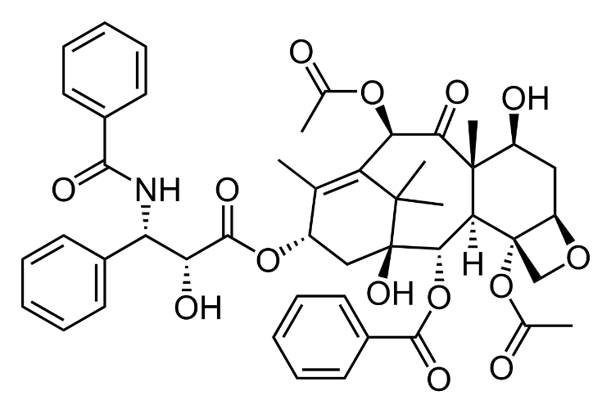
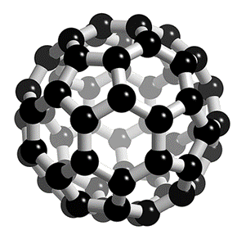
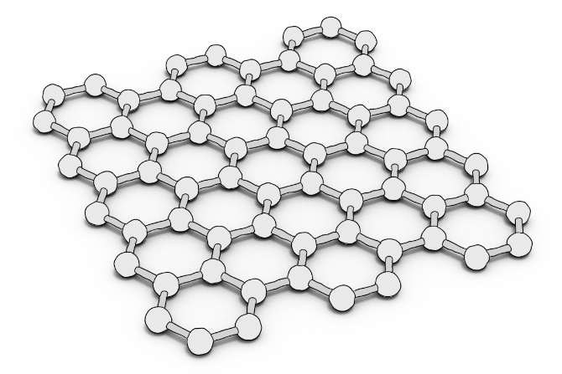
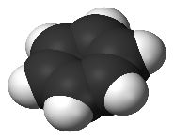
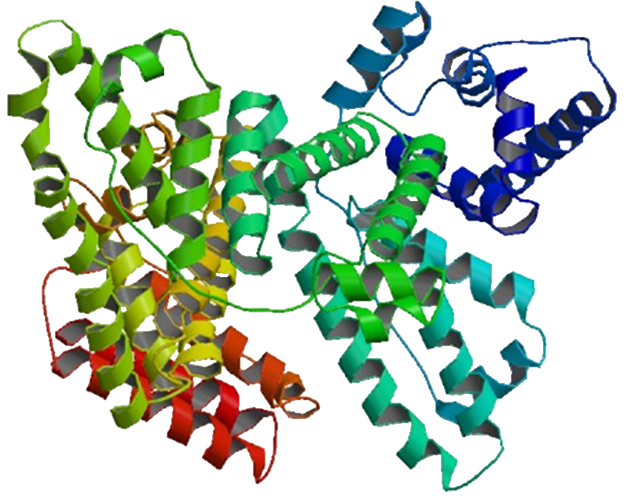
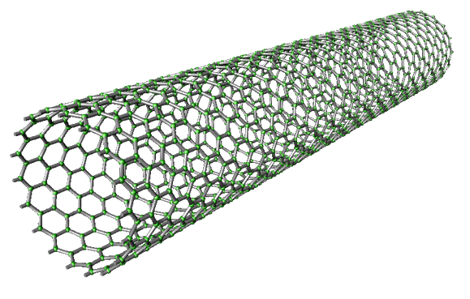
A Comparison of the NanoStructures We have Seen
1 nm
2 nm

Slide 20
Summary
We have examined how science generates fundamental knowledge on which innovators bring strands of knowledge together to create products and processes to fulfil a human need (technology).
We have appreciated how you can step down in length scale by powers of 10 to go from the:
  macroscopic world which we can see with our eyes (0.1mm and above),
  to the microscopic world which we can only see with an optical microscope (200 nm or 0.2 μm and above),
  down to the nanoscopic world where you need advanced microscopies to visualise materials (1-100 nm)
  Right through to the molecular world (0.1-10 nm), and
  Ultimately to the world of atoms (0.01-0.6 nm).
We have defined nanotechnology as a technology which uses a length scale between 1-100 nm in the material or processes, and looked at:
  Nanomedicine: we saw how Abraxane was a formulation of the drug paclitaxel and an albumin protein nanoparticle (7nm). The nanoparticle enhanced paclitaxel properties, due to the nanoparticle increasing the drug solubility and targeting the drug to cancer cells.
  Nanofabrication and Nanoelectronics: we saw how a process called photolithography has led to a reduction in the size of transistors from centimetre to just a few nanometre in the last 5 decades (Moore’s law), which has driven the ever increasing pervasiveness of electronics in our everyday lives.
  Nanomaterials: We considered how the new nano-allotropes of carbon (C₆₀ (Dia = 1 nm), graphene (1-10 nm), and carbon nanotubes (1-20 nm)) are being used (i) to strengthen materials in composites, (ii) in touchscreens and (iii) batteries, and how C₆₀ may be used in solar cells and in nanofabrication processes.

Slide 21
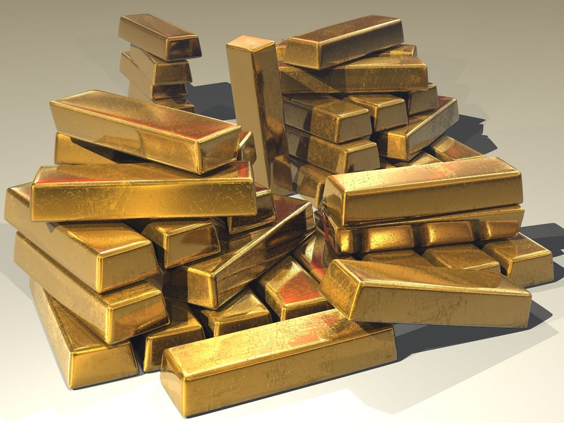
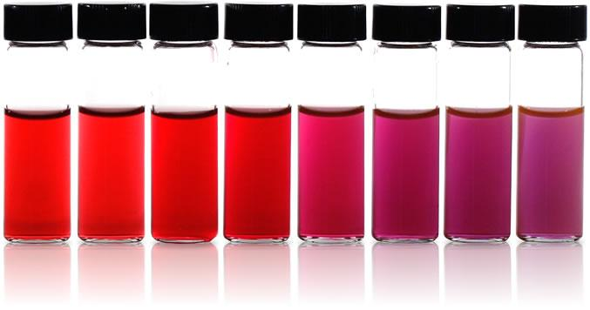
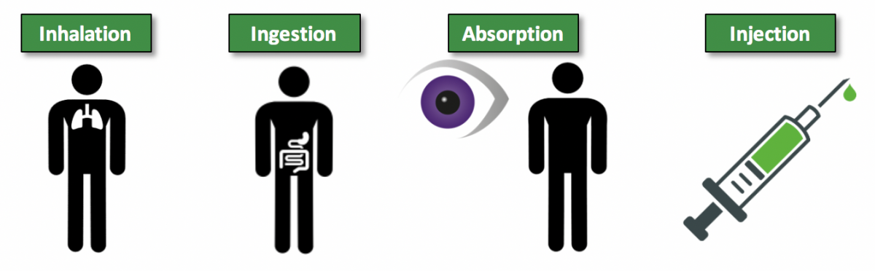
The Next Two Lectures
Lecture 2 will examine length scales some more, looking in more details at stepping down in powers of 10 from the macroscopic to the nanoscopic world.
In addition, the lecture will look at how the properties of nanoparticles can dramatically change from the bulk material they are formed from. For example:
gold nanoparticles are not gold coloured, but can be a variety of colours depending upon the size and shape of the particulate.
Gold and silver nanoparticles are no longer unreactive like the bulk metal, but chemically reactive, being used as catalysts and antibacterial agents.
Bulk gold
Nanoparticulate gold
Lecture 3 will consider the risks associated with engineered nanoparticles, in particular how they might get into a human and why they are potentially more dangerous than larger particulates of the same material.

Slide 22
Learn and Question Some More
https://www.youtube.com/watch?v=-KY4MKIZY2Y&feature=emb_logo
https://www.youtube.com/watch?time_continue=151&v=dQhhcgn8YZo&feature=emb_logo
https://www.diffen.com/difference/Science_vs_Technology
https://www.azonano.com/article.aspx?ArticleID=1207
https://en.wikipedia.org/wiki/Orders_of_magnitude_(length)
https://en.wikipedia.org/wiki/Nanoscopic_scale
https://iopscience.iop.org/article/10.1088/0957-4484/14/1/001?gclid=Cj0KCQjwyur0BRDcARIsAEt86IACdUR7Ze0-I2wdOJZaU1rzzw42yf9gBKsQiap4wI8DT-4kgdnRLY8aAiYNEALw_wcB
https://www.nano.gov/nanotech-101/what/definition
https://en.wikipedia.org/wiki/Nanomedicine
https://etp-nanomedicine.eu/about-nanomedicine/what-is-nanomedicine/
https://www.nanowerk.com/nanofabrication.php
https://www.worldofmolecules.com/nanotechnology/
https://www.youtube.com/watch?v=IesIsKMjB4Y
https://www.graphene.manchester.ac.uk/learn/applications/
https://www.youtube.com/watch?v=dnE1nO6o-do
https://www.youtube.com/watch?v=Mcg9_ML2mXY
https://www.explainthatstuff.com/graphene.html
https://www.nanowerk.com/nanotechnology/introduction/introduction_to_nanotechnology_22.php

